Slide 1
ATLS 5214 – BIG DATA ARCHITECTURE
Twitter map with emojis
TeamSimple
Team Members:
Xu Han(Team Lead), Yichen Wang, Dongyao Wang,
Tianshu Pang, Ali Raza, Peng Yan

Slide 2
Problem
Every second data is generated by the users of the computer system around the globe. It is important to harness the power of this tremendous amount of data and mine it for understand the bigger patterns behind it.
This can provide us with the trends that can be utilized for predicting the global changes in the landscape of any field. Similarly, social media provides us with a wealth of information and it can provide us with an in depth understanding about people from different cultures and popular trends in a particular country.

Slide 3
Inspired by : Live Tweets Around the World

Slide 4
Introduction
Utilizing twitter data for understanding the sentiments of people from different countries in different continents: USA, UK, Japan, Australia, Brazil, South Africa
For telling a data story, we imagined using different visualizations reflecting the emotions in the emoji’s
We then analyzed the data from twitter from the selected countries and project them in our visualization dashboard

Slide 5
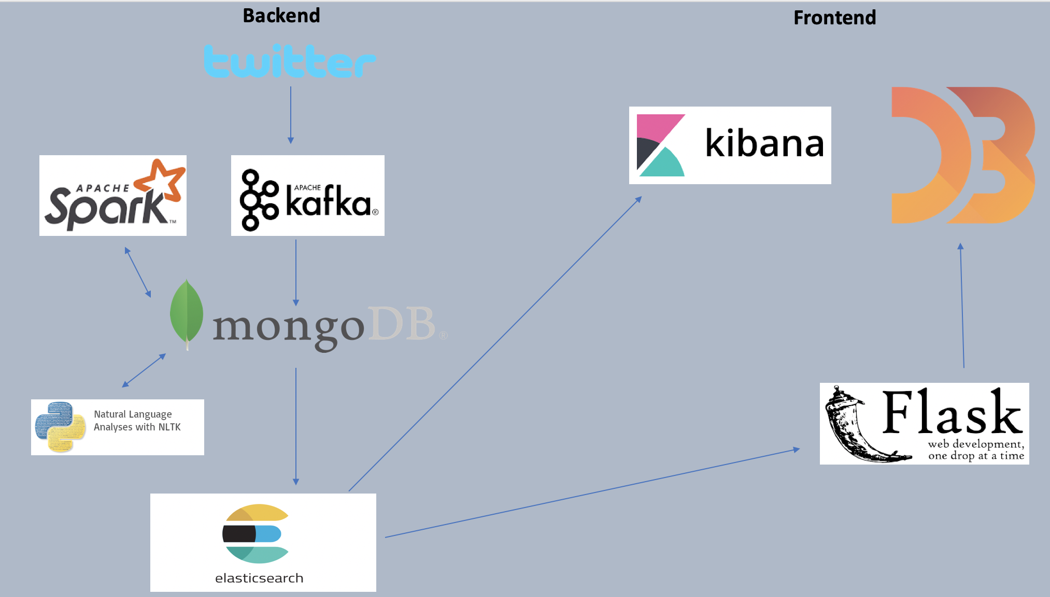
ARCHITECTURE

Slide 6
Live Demo
Live link:
Video:
Notes:
Video:

Slide 7
Challenges
Figuring out the dynamics of the team at the start of the project
Understanding on how to install the setups required in the initial phase of the project
Scheduling of time to work together as a group
Selecting the right cloud platform for the deployment
Projecting our backend work with the idealized visualization at the start of the project

Slide 8
What will we do with more time
Use larger dataset for testing the limits (maybe buy advanced api access)
Live refresh of the statistics (not refresh every minute)
Use machine learning for making predictions about the emotions of different regions
Mine data for understanding of the fake news spread on social media (twitter)

